Slide 1

GOLD PRICE PRIDICTION
Group members :
Aditya Prakash
Yashvardhan Hemantrao Patil
Bushra
Yashas R
Sagar Subhas Chalekar
Pamula Sasivardhan

Slide 2
Steps involved :
EDA
Visualatation
Model Buliding
Deployment

Slide 3
EDA :
Exploratory Data Analysis (EDA) is an approach that is used to analyze the data and discover patterns, or check assumptions in data with the help of statistical summaries and graphical representations; It can also help determine if the statistical techniques you are considering for data analysis are appropriate.

Slide 4
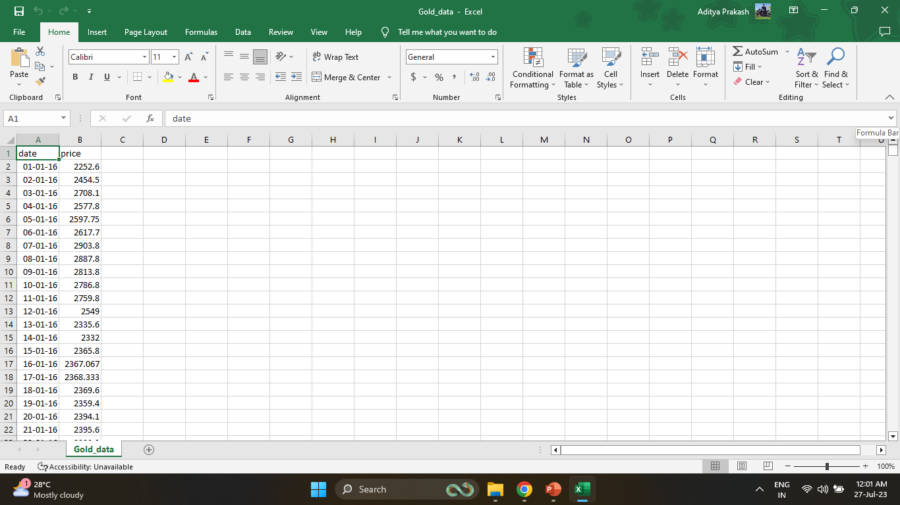
Given data set

Slide 5
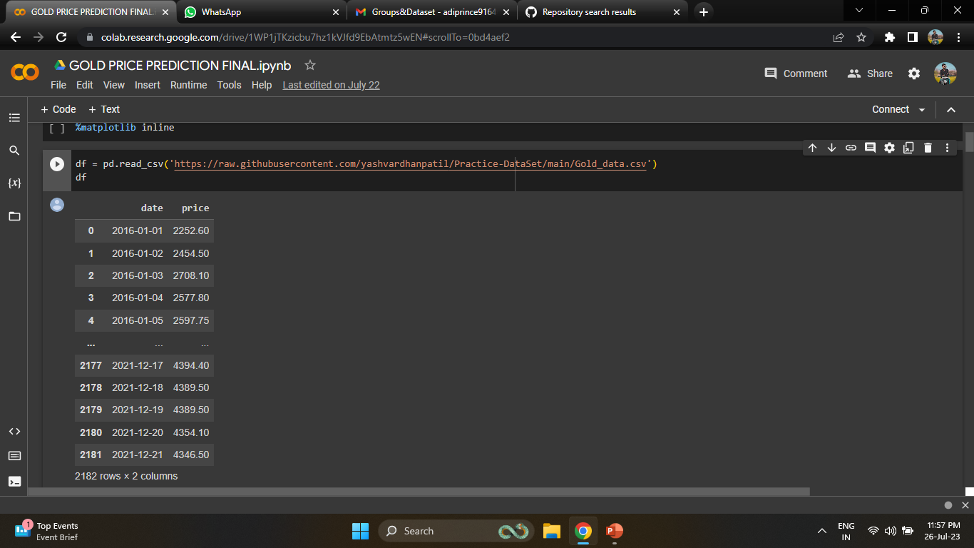

Slide 6
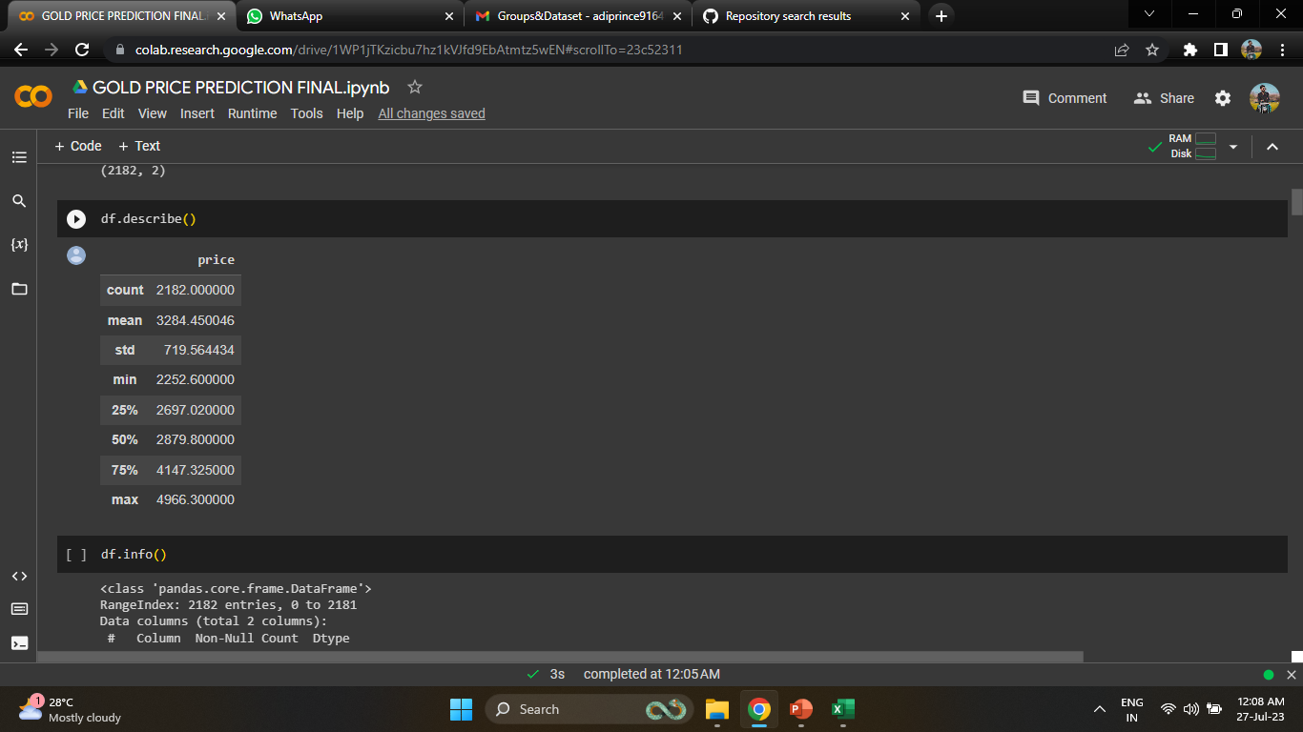
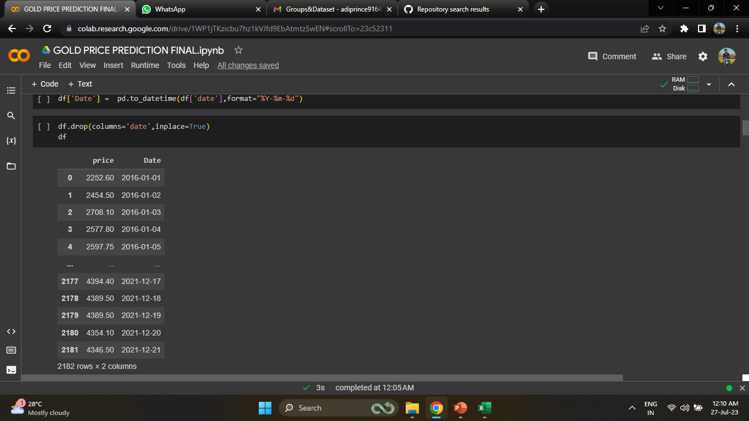
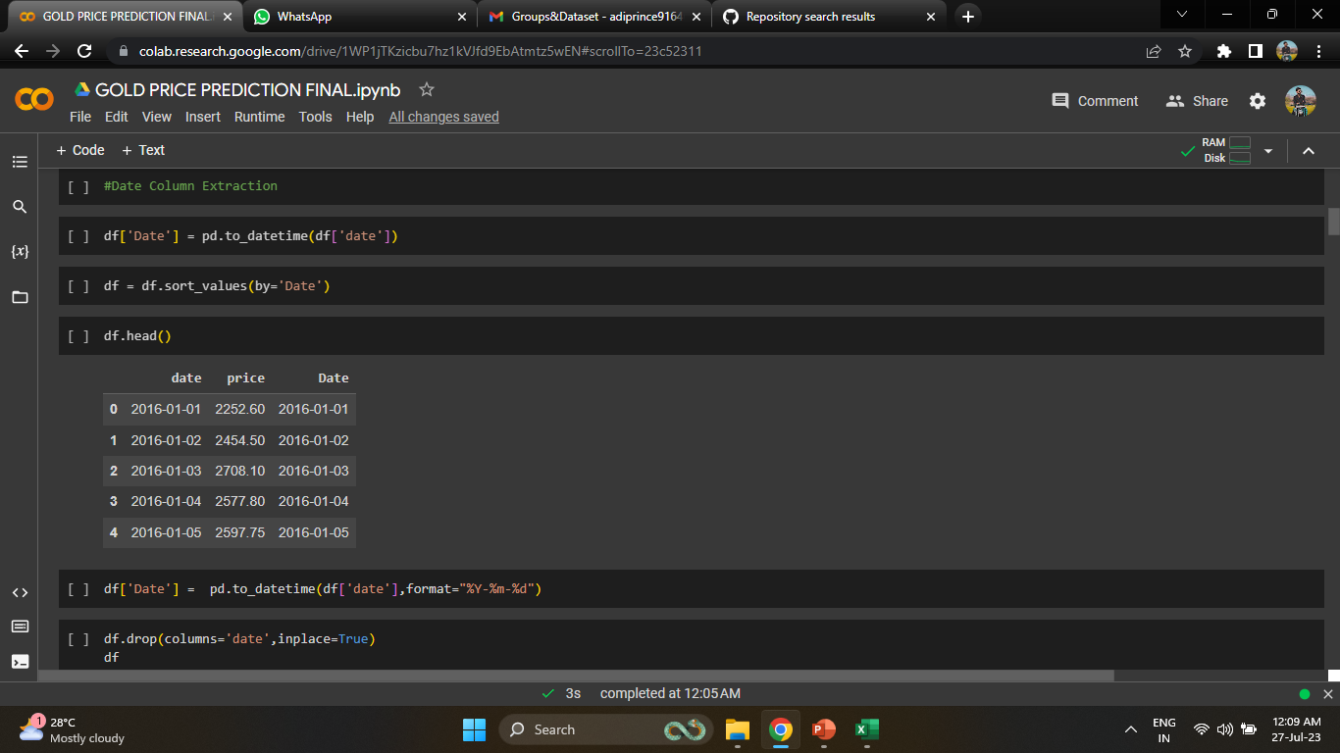
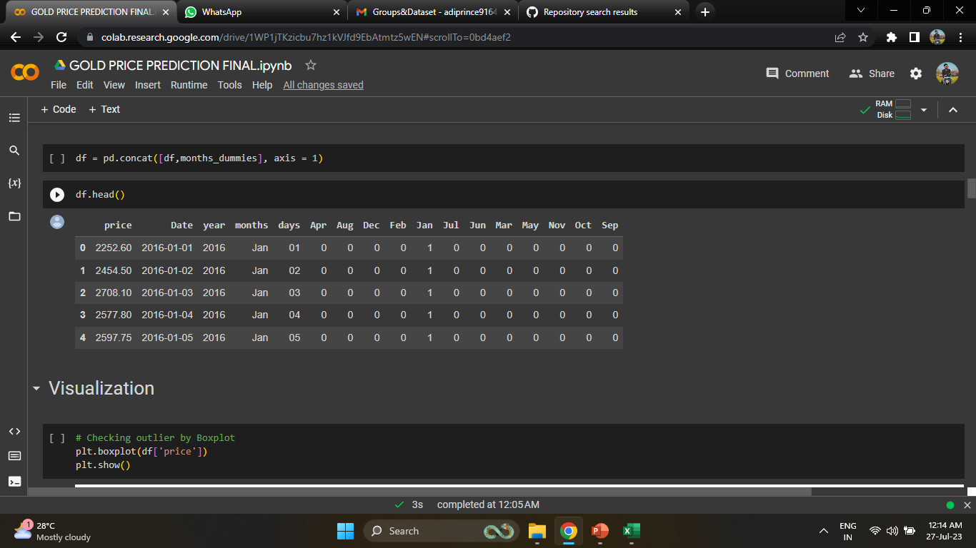

Slide 7
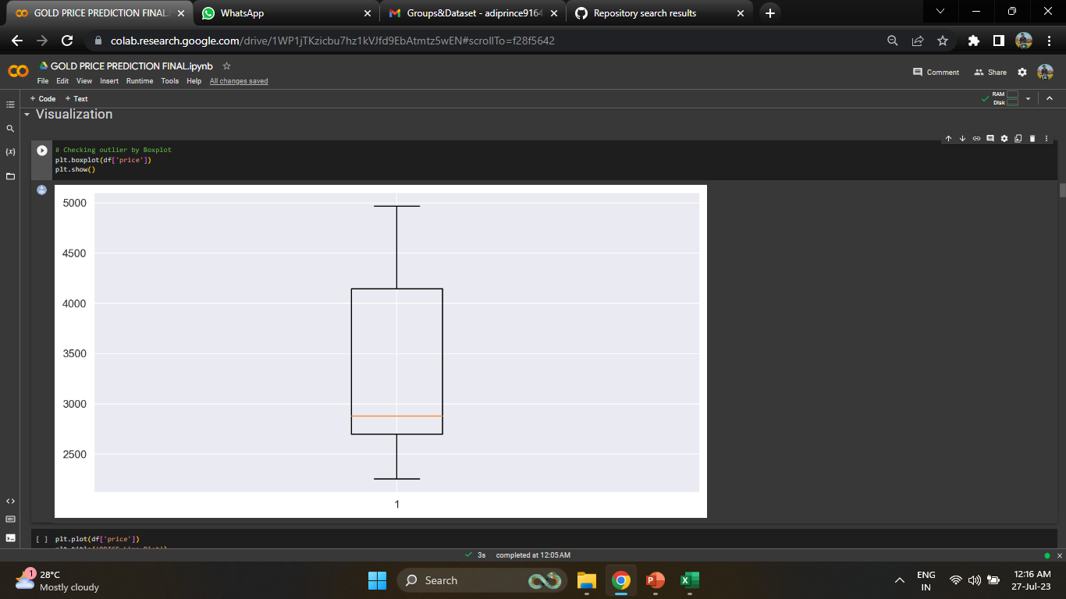
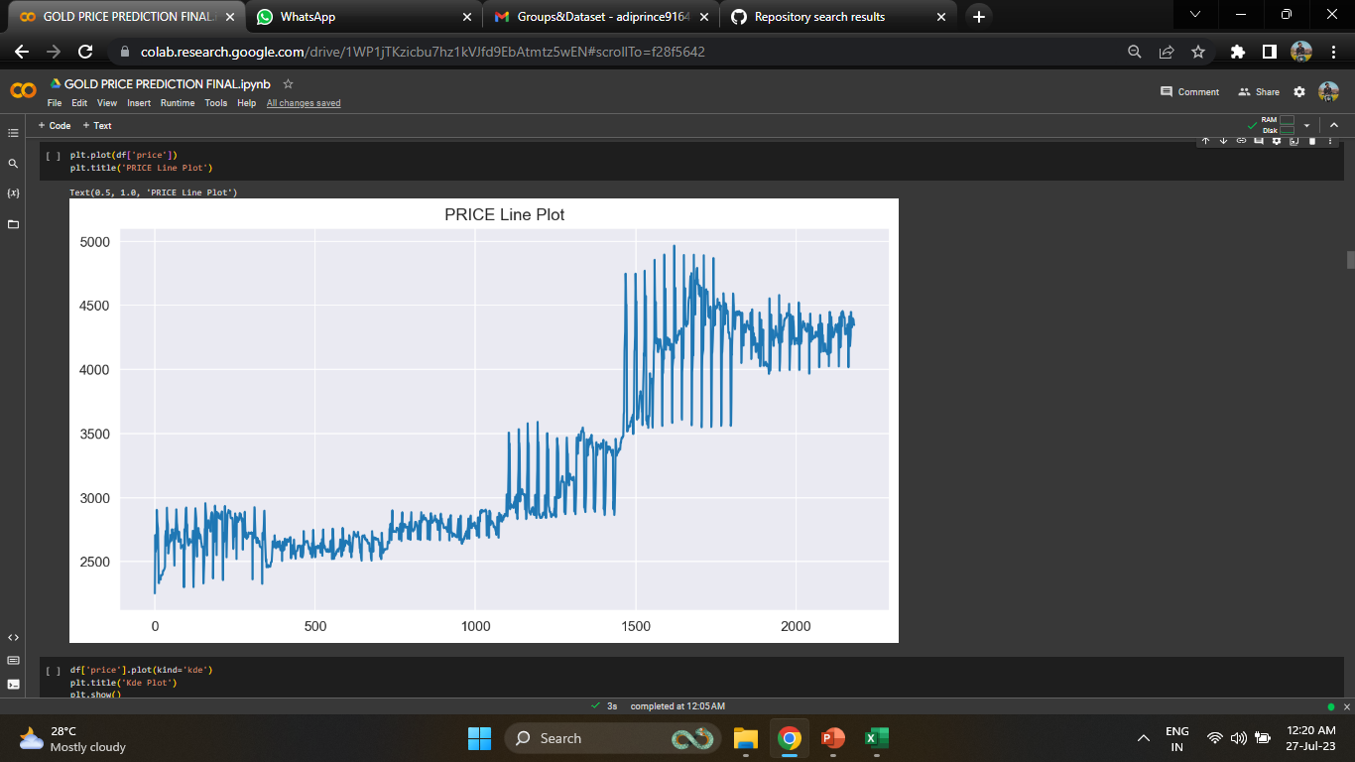
Visualization

Slide 8
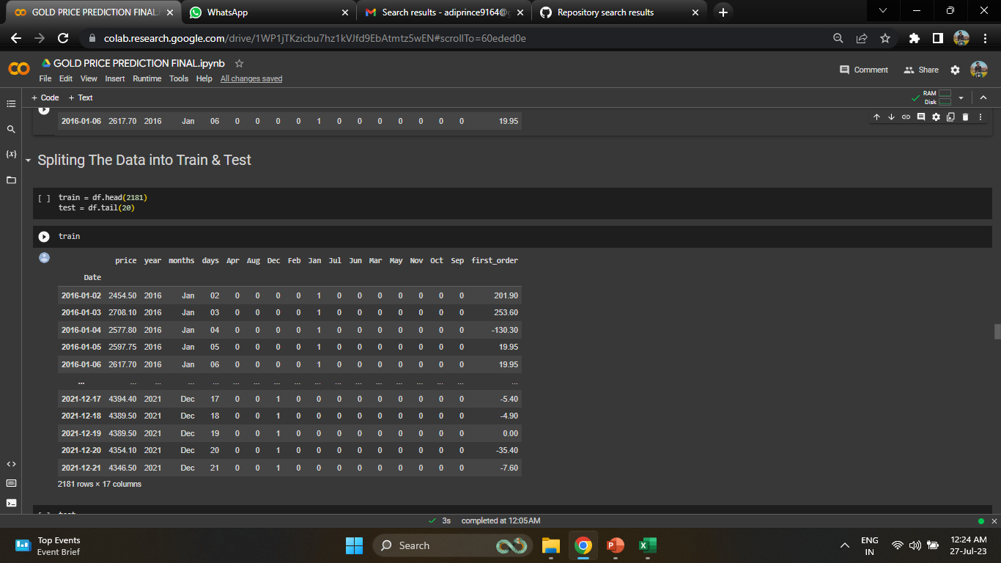
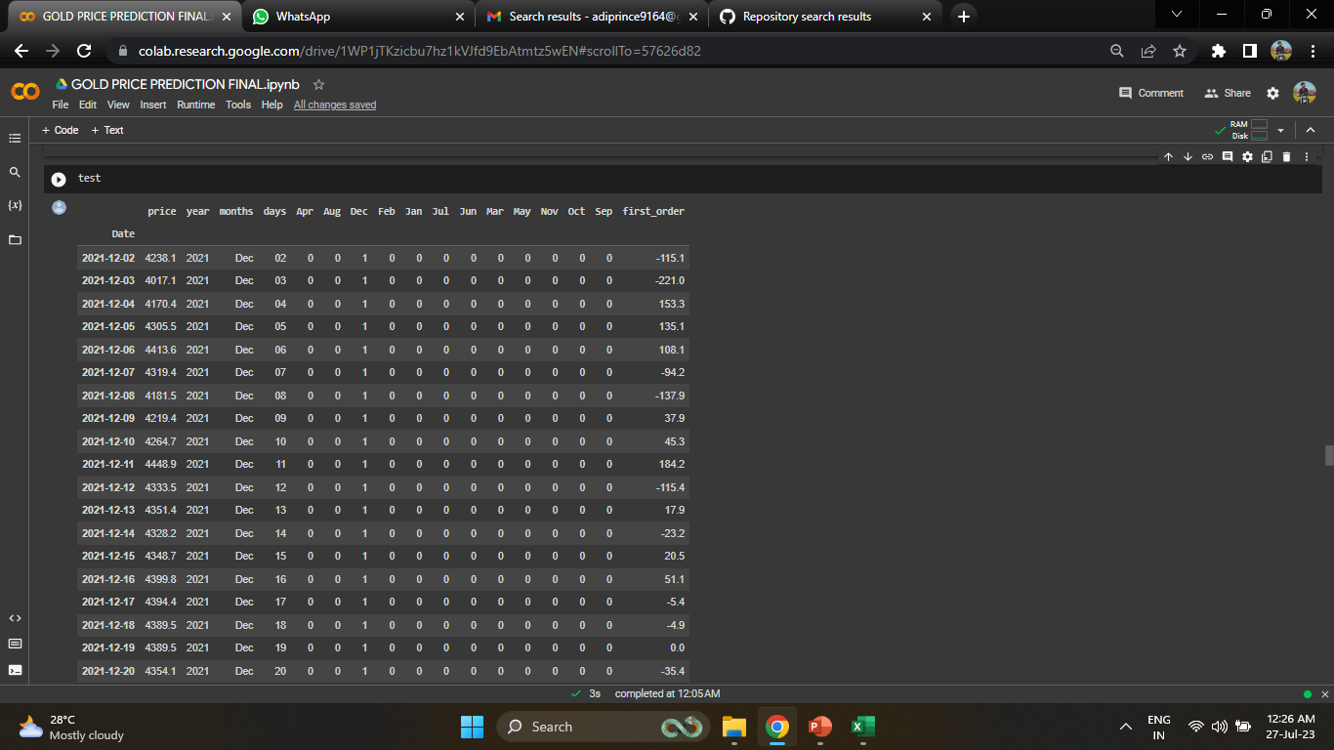

Slide 9
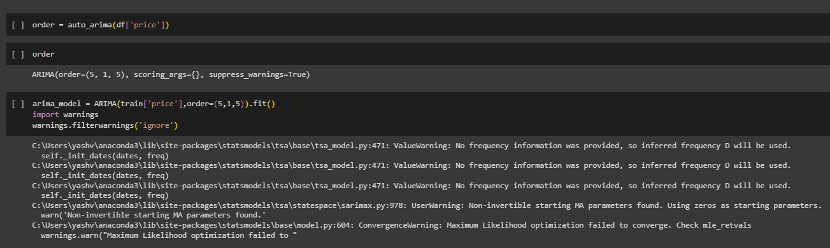
Model Building
ARIMA Model

Slide 10
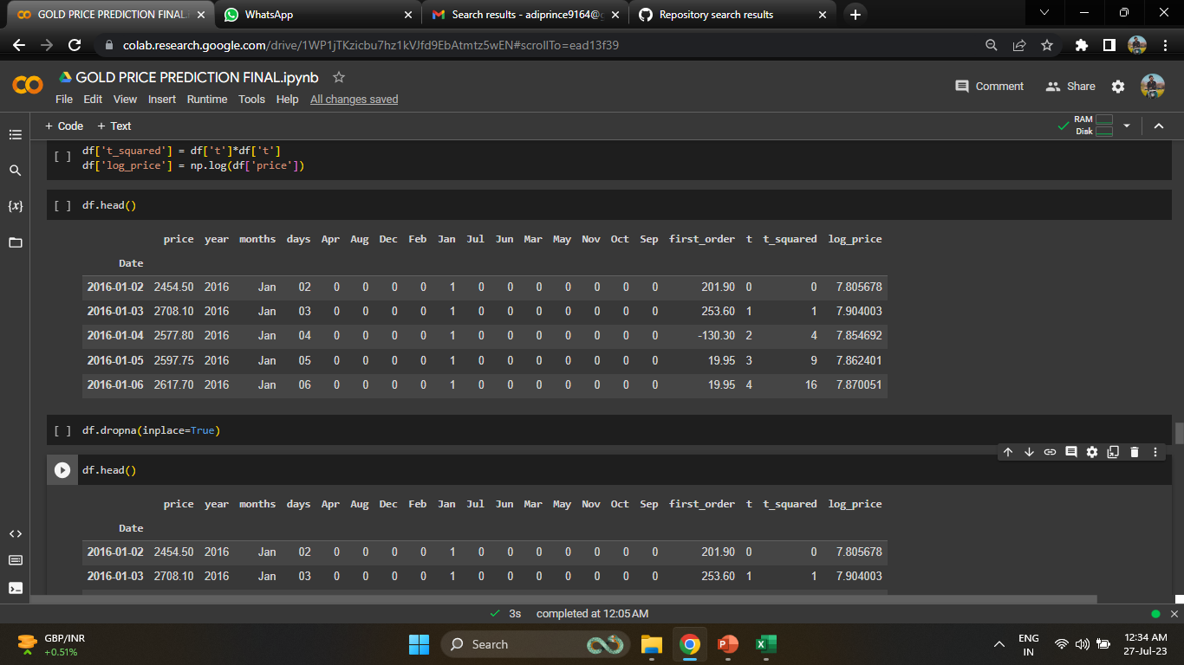
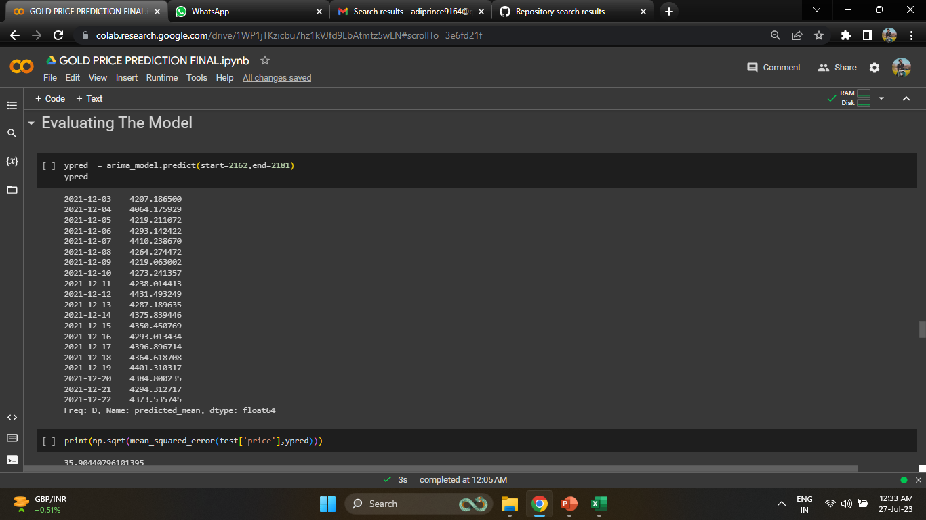
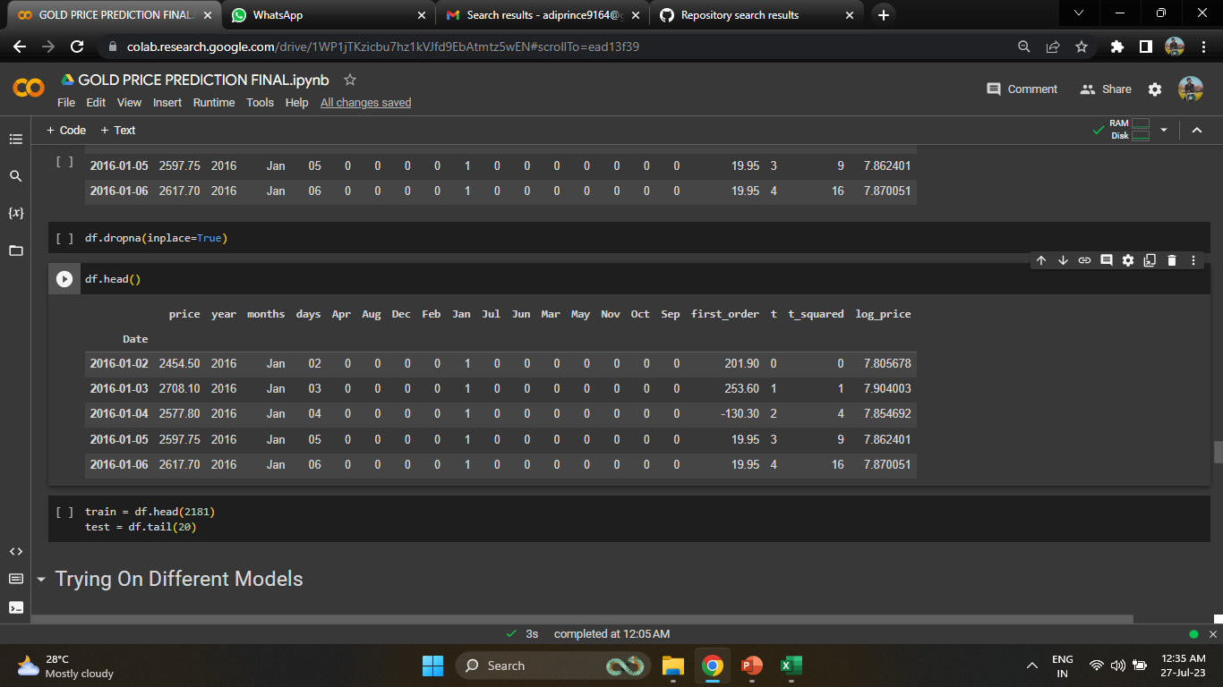

Slide 11
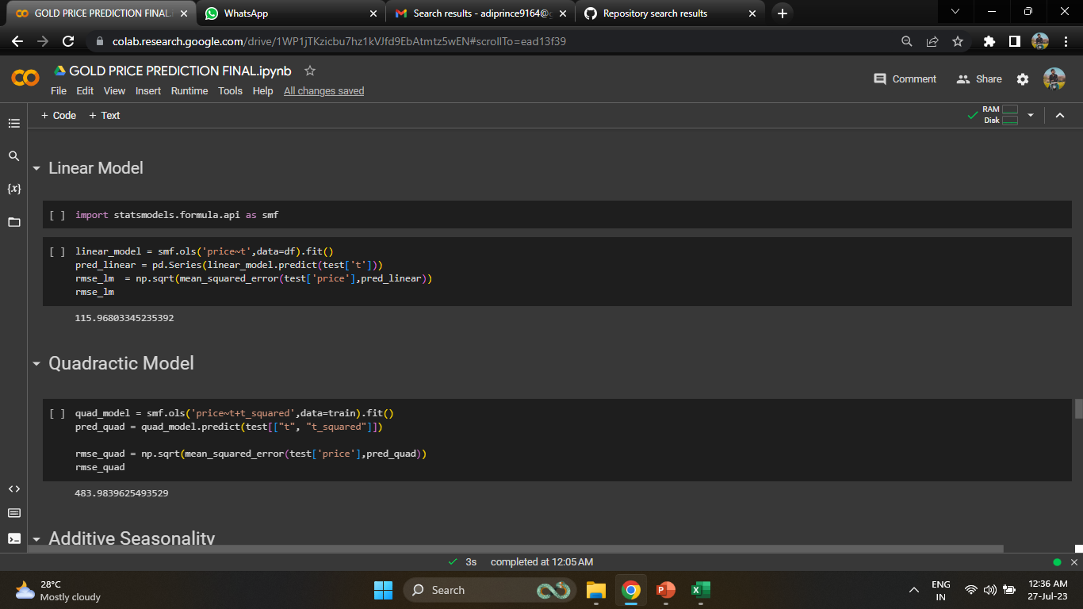
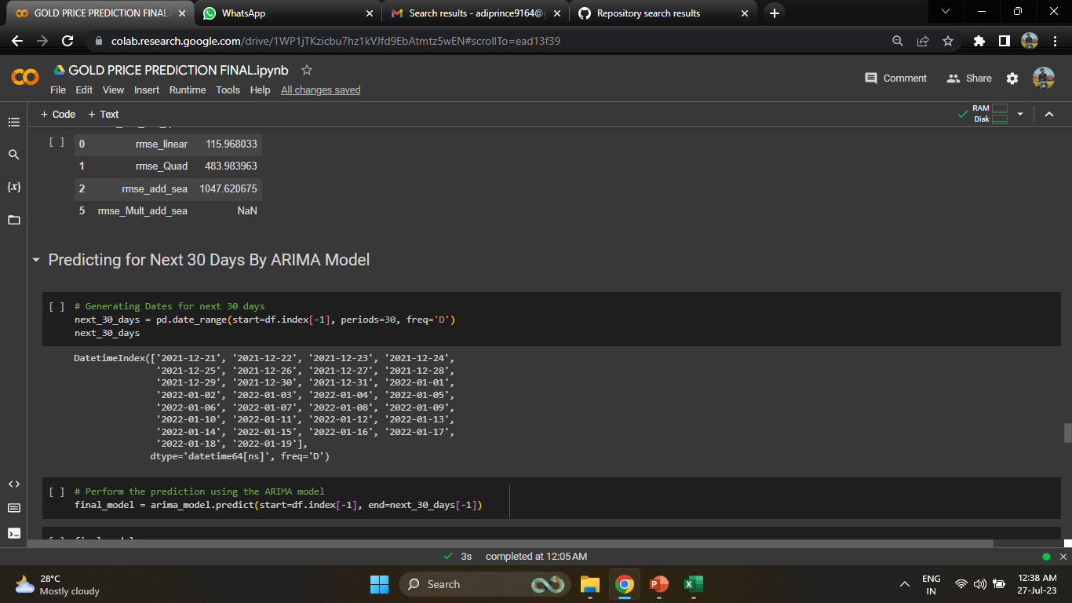

Slide 12
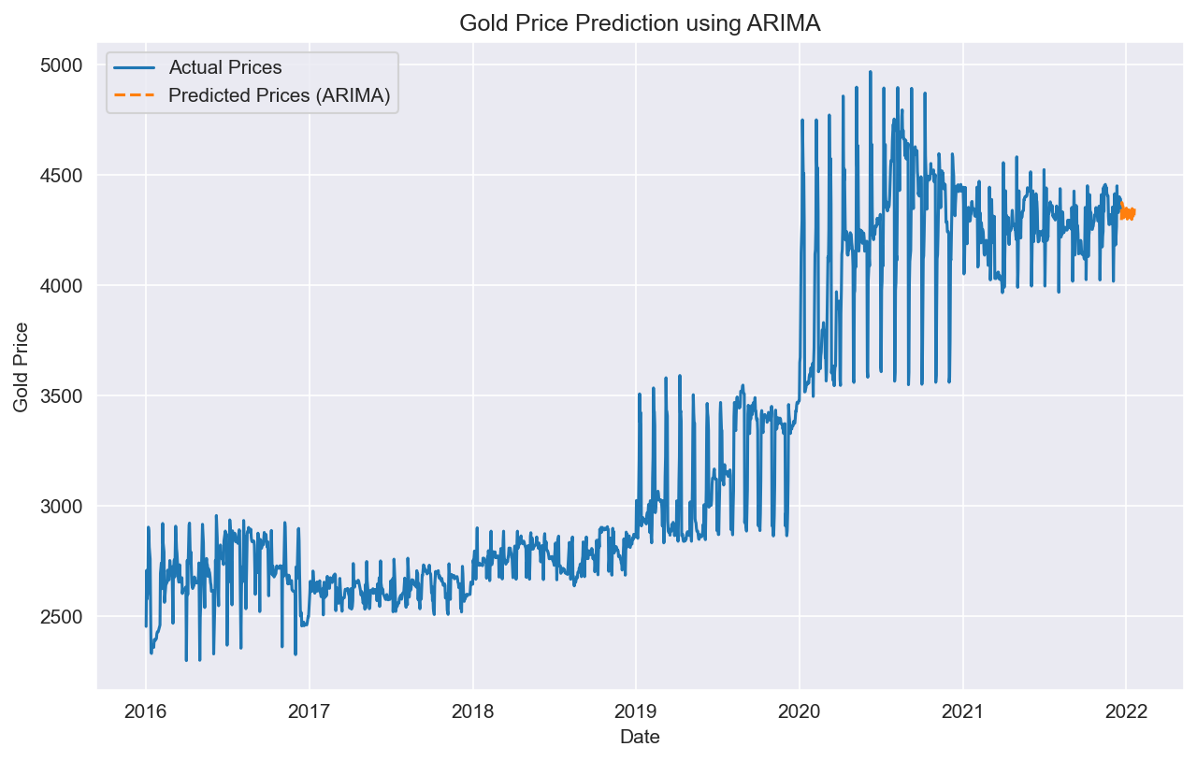

Slide 13
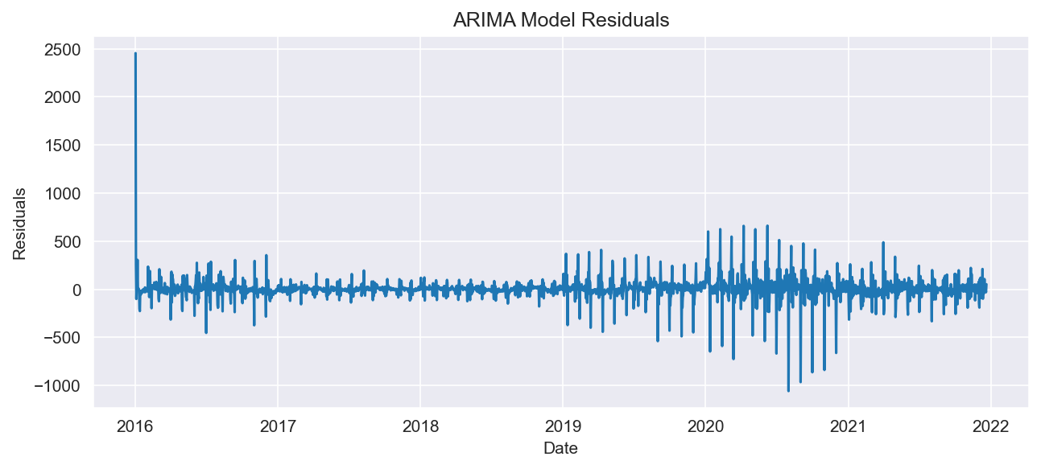

Slide 14
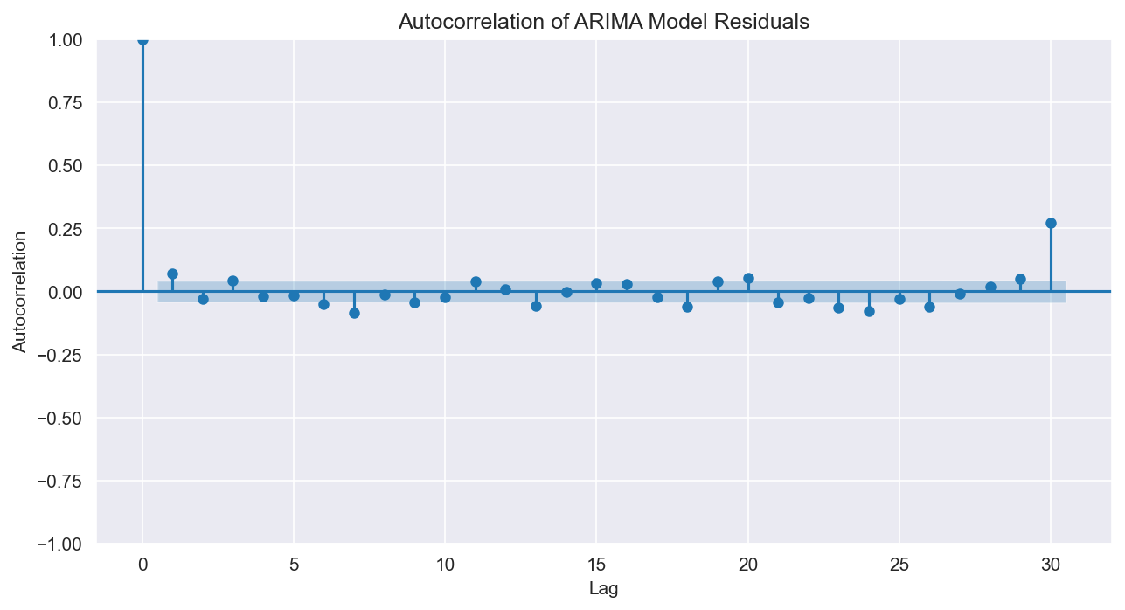
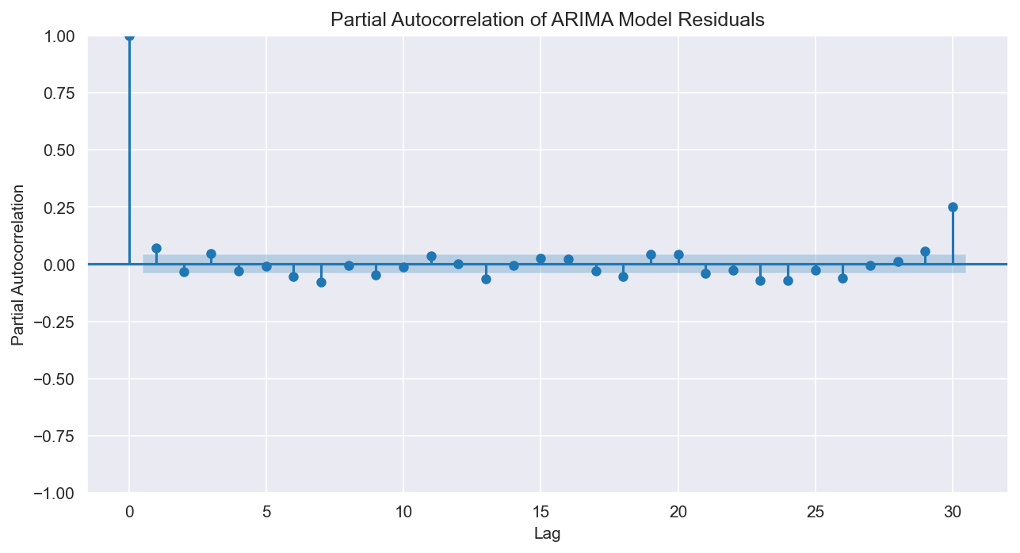

Slide 15
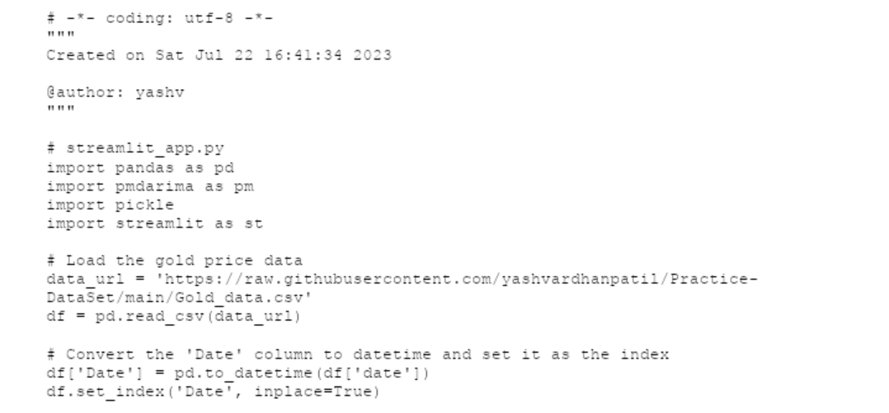
DEPLOYMENT

Slide 16
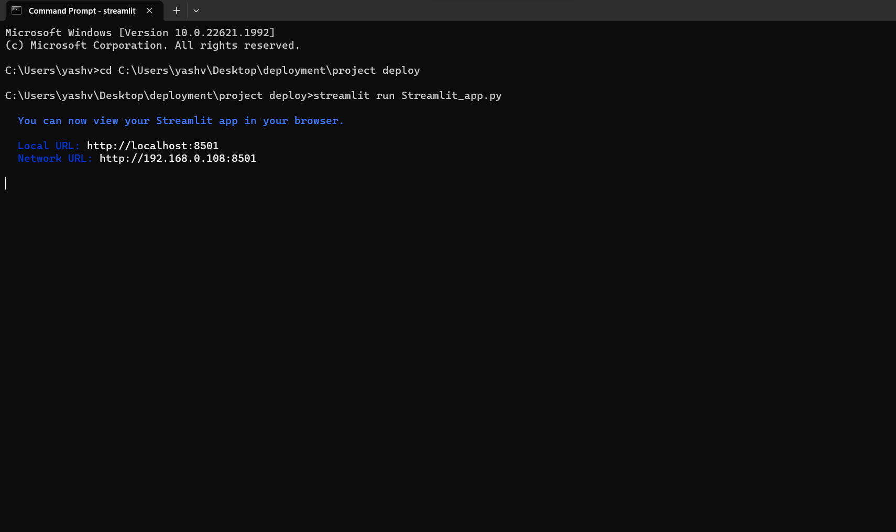

Slide 17
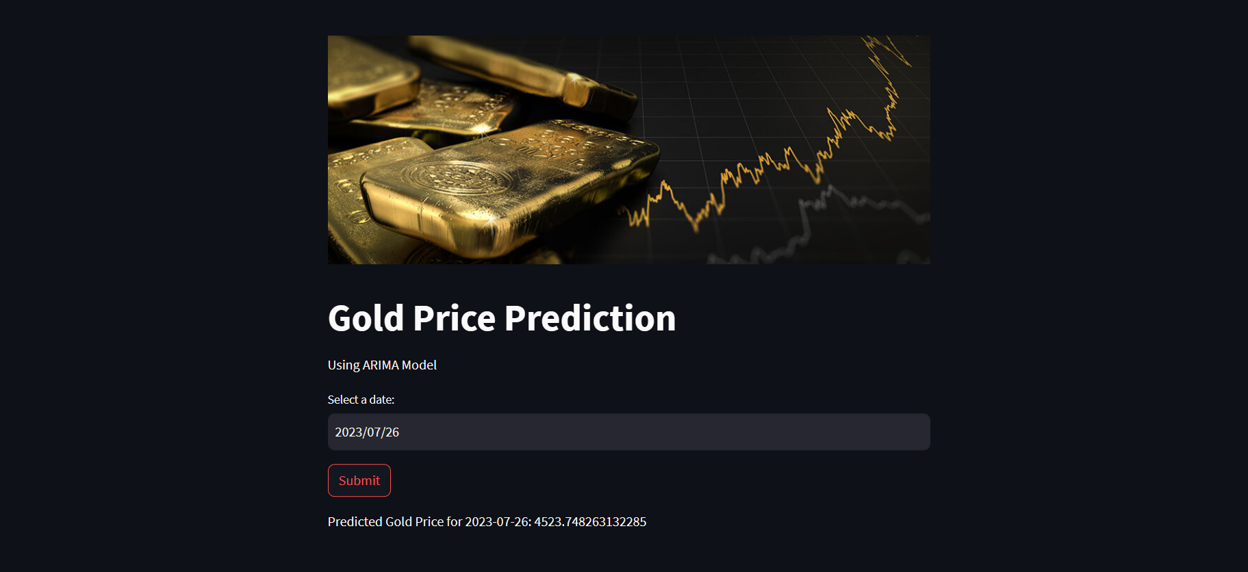

Slide 18
THANK YOU

